Slide 1
Looking after your health and wellbeing
Keeping you & your family, in the best of health
August 2021

Slide 2
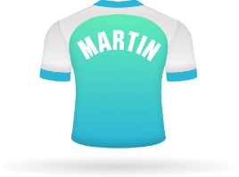
About Health Shield
Friendly by name, friendly by nature
Proud past, exciting future
We started in 1877, helping railway workers keep their health on track and we’ve not stopped since.
Members are our friends too
We do our best to look after your money. As a not-for-profit friendly society, what we do is in the sole interests of our Members.
Notes:
https://www.healthshield.co.uk/about-us/friendly-society/
Now we provide a wide range of modern health and wellbeing services to support our 330,000+ members.

Slide 3
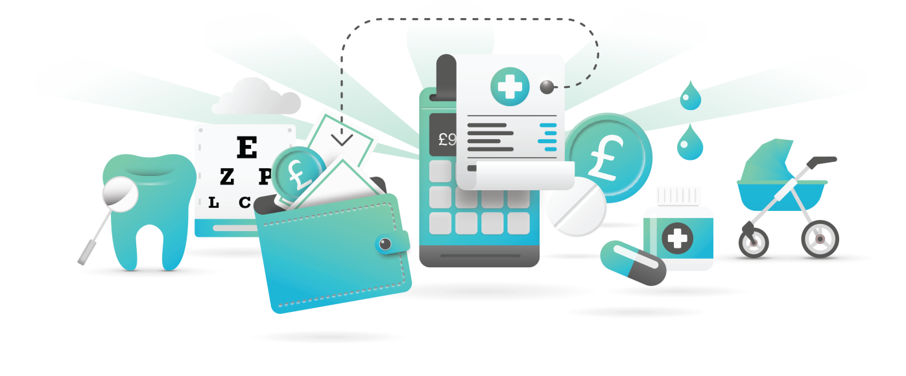
Health Cash Plans
Look after your wellbeing and claim back the costs of everyday healthcare
Easy to set up and use
No medical required
Different levels of cover for different budgets
Easy payment via payroll deduction
MyWellness package included
Children up to the age of 21 living at home studying full time are covered at no extra cost

Slide 4
Our Mission is to help people lead healthier,
happier, more productive lives.
So our services are designed with one aim in mind.
To help people stay in…
The best of health.

Slide 5
Dental and Optical
Dental
Spread the cost of dental treatment, from check ups to orthodontic treatments.
Dental Accident
Covers you in the case of an accident involving a direct blow to the head where your teeth are damaged.
Optical
Managing the costs of eye care, including eye tests, glasses and contact lenses.
Physical therapies and wellbeing
Chiropody
Claim back costs for professional foot care, so there’s no need to suffer from painful or unsightly feet.
Health & Wellbeing
Money back for a range of wellbeing treatments including massage and reflexology.
Combined Physiotherapy
Cashback for pain relieving physical treatments.
Notes:
https://www.healthshield.co.uk/about-us/friendly-society/
Now we provide a wide range of modern health and wellbeing services to support our 330,000+ members.

Slide 6
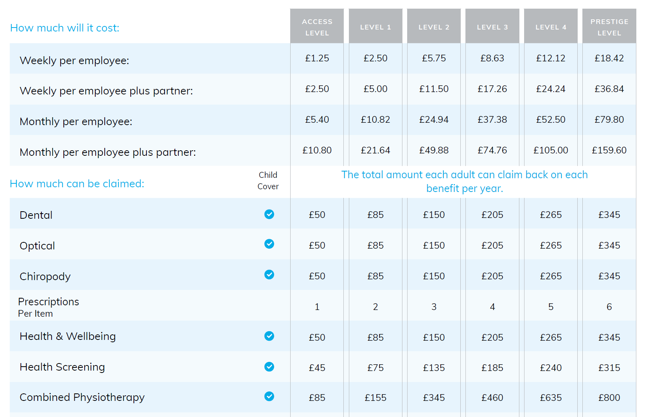
Corporate Cash Plan
Money back towards everyday healthcare treatments

Slide 7
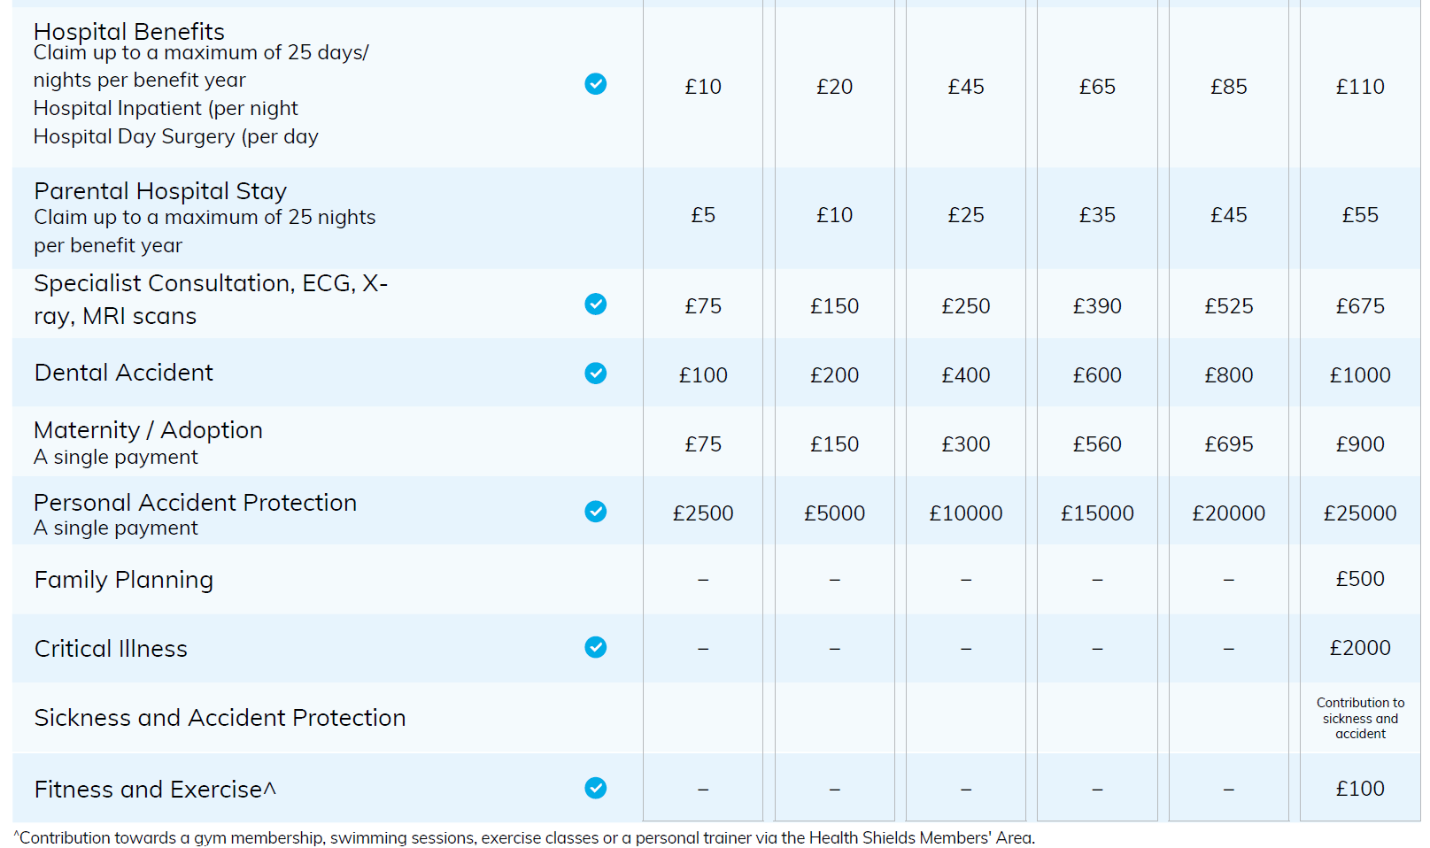
Corporate Cash Plan Cont’d…

Slide 8
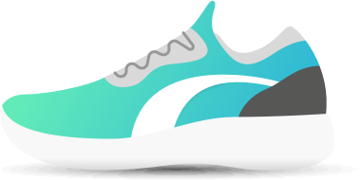
Prestige level benefits
Additional benefits for top tiered members
Family Planning
Pays out for fertility or sterilisation treatment for you and your partner (if they are included on the policy) in a private clinic.
Critical Illness
Pays out a single lump sum if you’re diagnosed with a serious illness, after a 13 week qualifying period.
Sickness and Accident
Your contributions covered (up to 12 months) if you are off work for more than 30 days due to sickness or injury.
Fitness and Exercise
Claim back up to £100 towards gym memberships, swimming lessons, exercise classes or personal trainer sessions.
Notes:
MATERNITY
Single payment if you, or your registered partner, has a child or adopts a child aged 16 or younger
NB: This benefit has a 40-week qualifying period

Slide 9
Your My Wellness
My GP Anytime
You can speak to a doctor via phone or video chat, and get prescriptions sent directly to your work or home address.
My Health Assessments
Prevention is better than cure. Having a health assessment can help you understand how important it is you look after yourself and can lead to early diagnosis of more serious conditions.
My Counselling
Our mental health and advice helpline offers you guidance around stress, financial worries, bereavements, physical health concerns and more.
My Home Assistance
Personal assistance with household chores, local shopping and mobility if you need a helping hand when you return home after a stay in hospital. Member and partner’s parents included.
My On Demand Physio
My On Demand Physio gives you fast access to advice from a qualified physiotherapist, with treatment for a wide range of conditions.
.
My Cancer Screening
Access to a selection of self-administered test that can detect the early stages of some of the most common cancers.
My PERKS
Discounts on purchases including fashion, holidays, entertainment, car hire, health and beauty and even weekly shopping from major supermarkets.
Notes:
https://www.healthshield.co.uk/about-us/friendly-society/
Now we provide a wide range of modern health and wellbeing services to support our 330,000+ members.

Slide 10
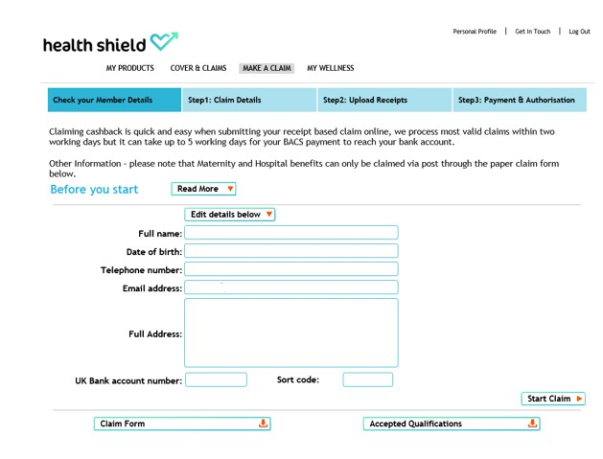
Members’ Area
Make A Claim is a quick, simple, with a secure area to submit claims and upload receipts – more than 9 out of 10 valid online claims are paid within 2 working days*
MyWellness brings together a range of products and services in a simple portal
*Once Members receive notification of a claim payment, it can take 3-5 working days for the BACS transfer to show as a credit in their account
Notes:
You can login to the members area at www.healthshield.co.uk/members using your computer, smart phone or tablet. Once registered, you can access your membership plan, see your cover and claims, make a claim and, access the my wellness benefits

Slide 11
Joining is simple..
Please find the link to the editable voluntary application form here Voluntary Application
Once completed, please email back across to me.
Kind regards
Nicky ☺

Slide 12
Any questions? Join today with IMMEDIATE BENEFIT ☺
Authorised by the Prudential Regulation Authority and regulated by the Financial Conduct Authority and the Prudential Regulation Authority.

